Slide 1
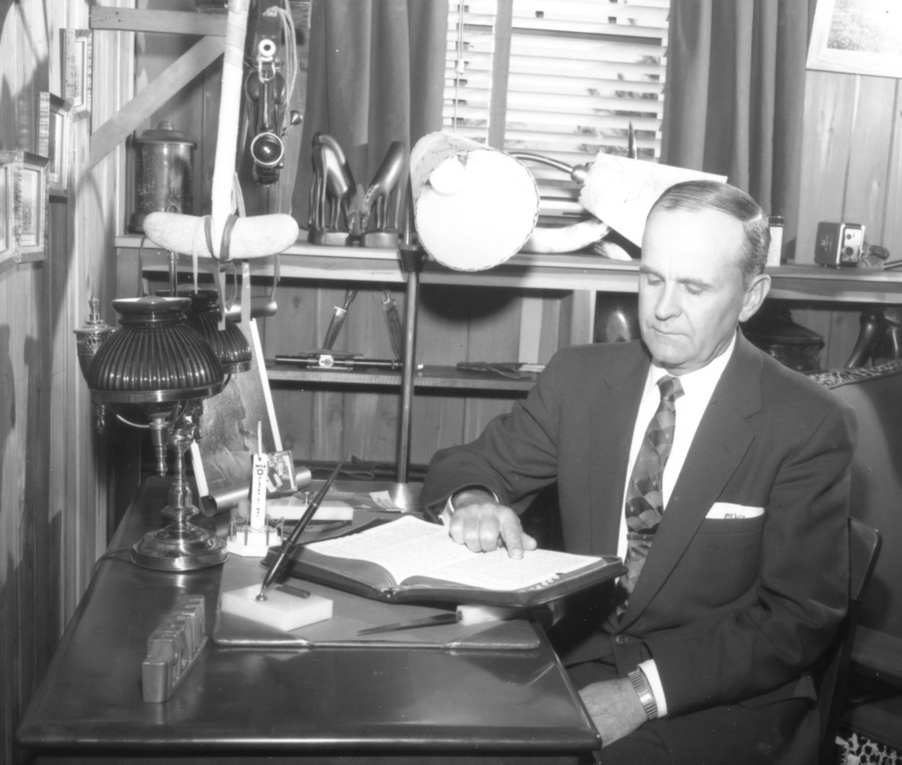
Living Prophecy The Dragon, the Beast and the Woman
#2

Slide 2
REVELATION 13 : 1 - 4
. . . the beast . . .

Slide 3
How does this differ in approach from the “Proving Your Faith Series”?

Slide 4
Proving You Faith – Focus on sharpening our understanding of what we know, proving to the unbeliever from scripture. Living Prophecy – Focus on using the message of the 7th Angel to interpret prophecy, identifying ourselves within those prophecies.

Slide 5
REFERENCES - 50 Years in the Church of Rome - From Convent to Pentecost - 1961 The Mark Of The Beast And The Seal Of God #1 / #2 - 1963 The Second Seal - 1965 The God Of This Evil Age - 1965 Satan's Eden

Slide 6
What does it mean to “pull”?

Slide 7
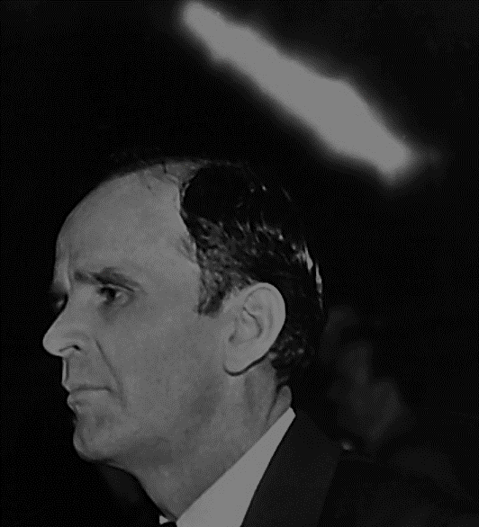
61-0216 The Mark Of The Beast And The Seal Of God #1
34 If He did heal her, then if He doesn’t heal you, He acted wrong then when He healed the first one, if you’ll meet the same requirements of faith that she did. It’s only based on one thing, “I can if ye believe.” That’s all. So, see, then it all lays back, no matter how much strain, or what we put on it, it’s not that, it’s relax and believe.

Slide 8
61-0216 The Mark Of The Beast And The Seal Of God #1
92 Now, we see that the Pentecostals is the one that’s got the faith, they believe, but, they’re full of Fire, they’re full of the Holy Ghost, but they don’t know how to settle down on that Word, and say, “It’s THUS SAITH THE LORD.” …

Slide 9
61-0216 The Mark Of The Beast And The Seal Of God #1
… They blow It all out the whistle with screams, and shouts, and runs. If they could ever bottle It down, you’d see a church stand on her feet in power and glory, there would be a Book of Acts wrote behind it.

Slide 10
61-0216 The Mark Of The Beast And The Seal Of God #1
93 Now, notice…Yeah, I didn’t mean that they…They take it out in joy, instead of power, faith. Hold that there and believe It, It’s God’s Word, stay right with It.

Slide 11
65-0801M The God Of This Evil Age
Whether you’re in holy Eden, or holy church, or holy denomination, or whatever it might be, you’ll die the day you disbelieve one Word of God’s Word to be the Truth, when It’s vindicated and proved to you. …

Slide 12
65-0801M The God Of This Evil Age
… That’s the day you separate yourself from God. Not just the whole sentence; one Word. “Whosoever shall add one word, or take One away,” that’s the day you die.

Slide 13
REFERENCES - 50 Years in the Church of Rome - From Convent to Pentecost - 1961 The Mark Of The Beast And The Seal Of God #1 / #2 - 1963 The Second Seal - 1965 The God Of This Evil Age - 1965 Satan's Eden

Slide 14
REVELATION 13
. . . the beast . . .

Slide 15
REVELATION 14
. . . the woman on the beast . . .

Slide 16
61-0216 The Mark Of The Beast And The Seal Of God #1
143 Confederation of churches, which will form the image of the beast, and we all know that. …

Slide 17
61-0216 The Mark Of The Beast And The Seal Of God #1
… See, there it is, all working right around now to bring all the churches together, unite ourselves together to fight communism. Don’t you worry about communism, it ain’t going to be the thing to fight.

